Slide 1
INTERVAl Cohort
cosmopolitan population in England
ORCADES cohort
isolated population in Orkney, Scotland
VIS cohort
isolated population in Vis, Croatia

Slide 2
ORCADES: no GO enrichment…

Slide 3
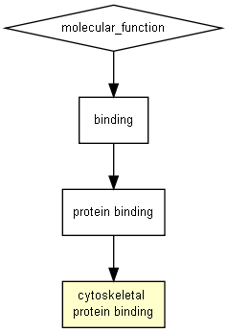
VIS: ambiguous vs matched
GO term | Description | P-value | FDR q-value | Enrichment (N, B, n, b) | Genes
GO:0008092 | cytoskeletal protein binding | 5.08E-4 | 3.58E-1 | 1.96 (264,11,135,11) | [-] Hide genes AXL - axl receptor tyrosine kinase ABL1 - c-abl oncogene 1, non-receptor tyrosine kinase CEACAM1 - carcinoembryonic antigen-related cell adhesion molecule 1 (biliary glycoprotein) LYN - v-yes-1 yamaguchi sarcoma viral related oncogene homolog TMSB10 - thymosin beta 10 FKBP4 - fk506 binding protein 4, 59kda CDH1 - cadherin 1, type 1, e-cadherin (epithelial) S100A4 - s100 calcium binding protein a4 ITGB1 - integrin, beta 1 (fibronectin receptor, beta polypeptide, antigen cd29 includes mdf2, msk12) PPP1R9B - protein phosphatase 1, regulatory subunit 9b HCLS1 - hematopoietic cell-specific lyn substrate 1

Slide 4
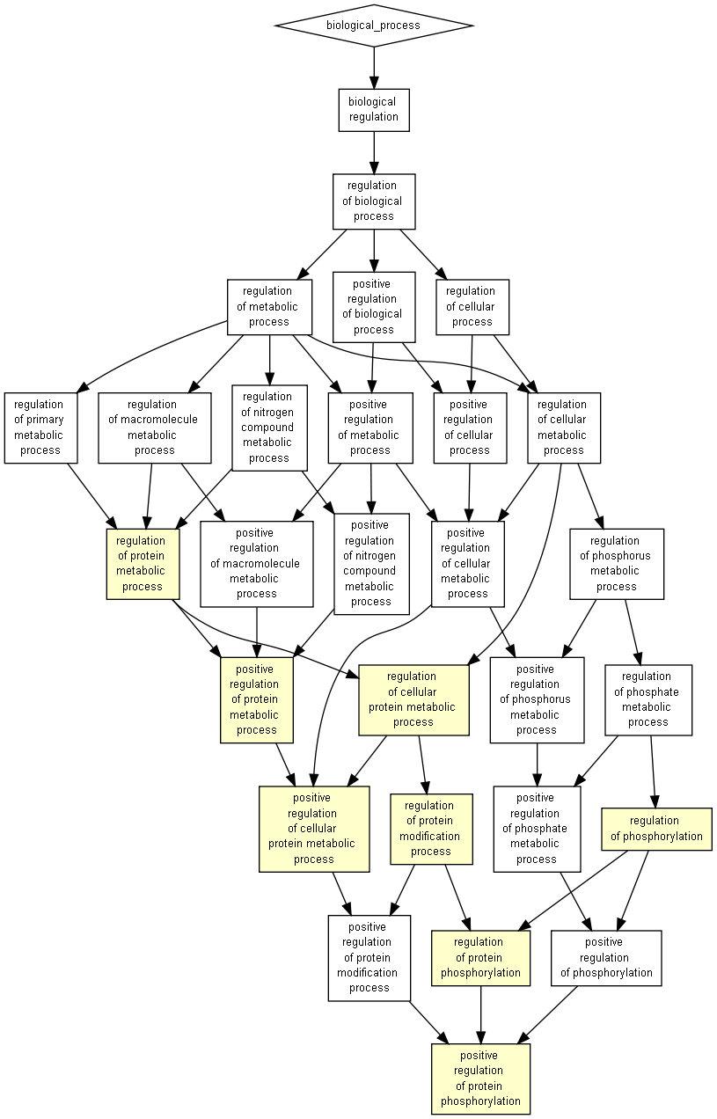
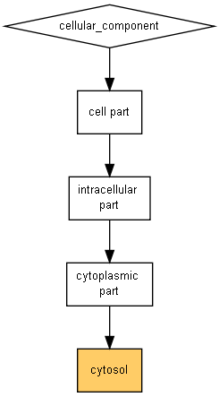
VIS: human inserted vs matched
http://cbl-gorilla.cs.technion.ac.il/GOrilla/rfyqmmsd/GOResults.html

Slide 6
